Slide 1


PROBABILITY DISTRIBUTION
Discrete Probability Distribution
Binomial Probability Distribution
Continuous Random variables
Uniform Probability Distribution
Normal Distribution

Slide 2
Probability Distribution
A variable is a symbol (A, B, x, y, etc.) that can take on any of a specified set of values.
When the value of a variable is the outcome of a statistical experiment, that variable is a random variable.
Example:
X represents the random variable X.
P(X = x) refers to the probability that the random variable X is equal to a particular value, denoted by x .

Slide 3
Probability Distribution
There are two types of random variables
DISCRETE
CONTINUOUS
0 ≤ X ≤ 8
Example: Height, weight etc
Probability Distribution
Cumulative
Uniform
Exponential
Normal
X = 1, 2, 3, …
Example: Number of cars, number of students etc
Probability Distribution
Binomial
Poisson

Slide 4
Discrete Random Variables
A discrete random variable can take on specific, isolated numerical values, like the outcome of a roll of a die, or the number of dollars in a randomly chosen bank account.
Example: X = 1, X = 2, X = 3 etc.
A coin is tossed ten times. The random variable X is the number of tails that are noted. X can only take the values 0, 1, ..., 10, so X is a discrete random variable.
A light bulb is burned until it burns out. The random variable Y is its lifetime in hours. Y can take any positive real value, so Y is a continuous random variable.

Slide 5
Discrete Probability Distribution
Probability distribution is a table or an equation that
links each outcome of a statistical experiment with its
probability of occurrence.
Consider the coin flip experiment.
The above table represents the probability distribution of the
discrete random variable X.
Note : The sum of all probabilities must be 1
: Negative probabilities are not permitted
Number of heads | Probability
0 | 0.25
1 | 0.50
2 | 0.25

Slide 6
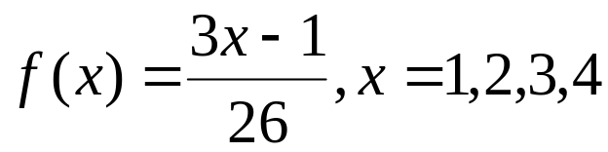




Discrete Probability Density Function
If the function
then the probability distribution is:
The sum of the probabilities is 1. If there is a defining
f(x) which is associated with the probability distribution,
then the probabilities and the function are known as
probability density function (or pdf)
x | 1 | 2 | 3 | 4
P(X=x)

Slide 7
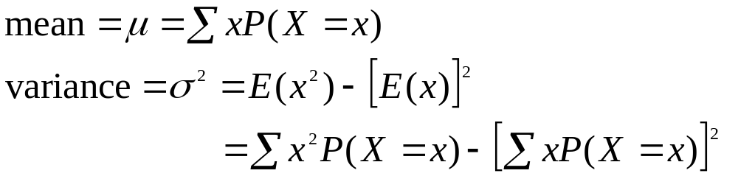
Discrete Random Variable
Mean and variance for discrete random variable as below:

Slide 8
Binomial Probability Distribution
A binomial random variable is the number of successes in a series of trials, for example, the number of 'heads' occurring when a coin is tossed 50 times.
The trials must meet the following requirements:
(a) the total number of trials,n is fixed in advance;
(b) there are just two outcomes of each trial; success and failure;
(c) the outcomes of all the trials are statistically independent (the outcome on one trial does not affect the outcome on other trials)
(d) all the trials have the same probability of success.

Slide 9
Binomial Probability Distribution
If a discrete random variable X is said to follow a Binomial distribution with parameters n and p, written
X ~ Bi(n,p) or X ~ B(n,p), it has probability distribution:
where
  x = number of success; 0, 1, 2, ......., n
  n = number of trials; 1, 2, 3, .......
  p = success probability; 0 < p < 1
  q = 1 - p
The Binomial distribution has expected value or mean E(X) = np and variance E(X²) = npq = np(1-p).

Slide 10

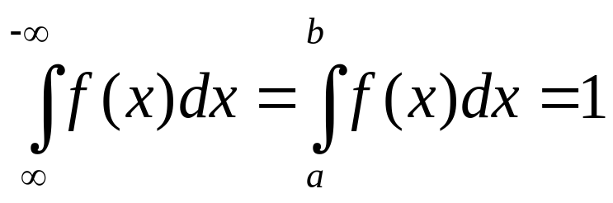

Continuous Random Variables
A continuous random variable is a random variables which takes any value that lies in an interval
example: 2 ≤ X ≤ 10
In general, for a function, f(x), to represent a probability density function for a continuous random variable,
(a) f(x) is defined and f(x) ≥ 0 for all
(b) the total area under the curve f(x) between x = a and x = b is:

Slide 11
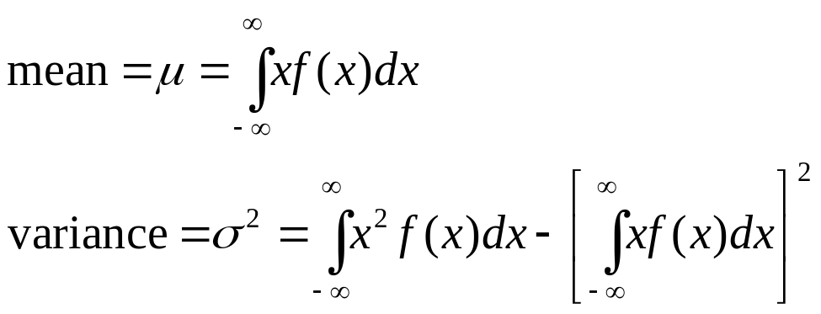
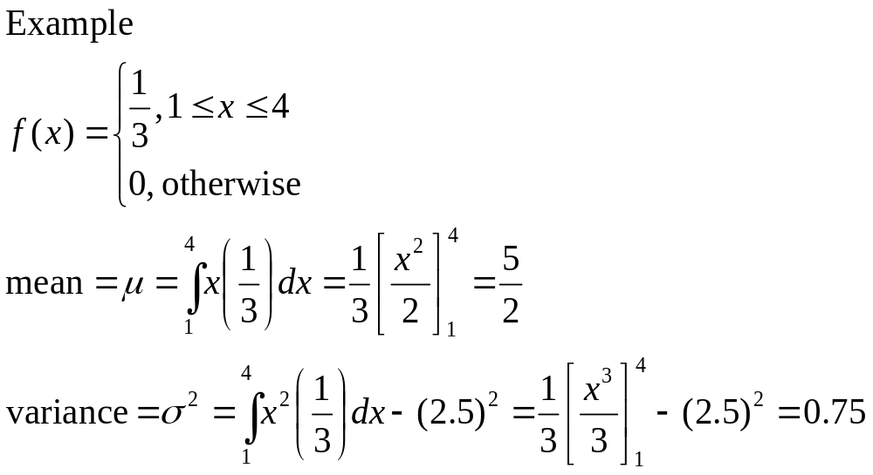
Continuous Random Variables

Slide 12
Continuous probability
Generally,
Median = P(X < M) = 0.5
First quartile = P(X < Q1) = 0.25
Third Quartile = P(X < Q3) = 0.75

Slide 13
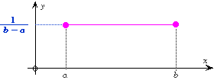
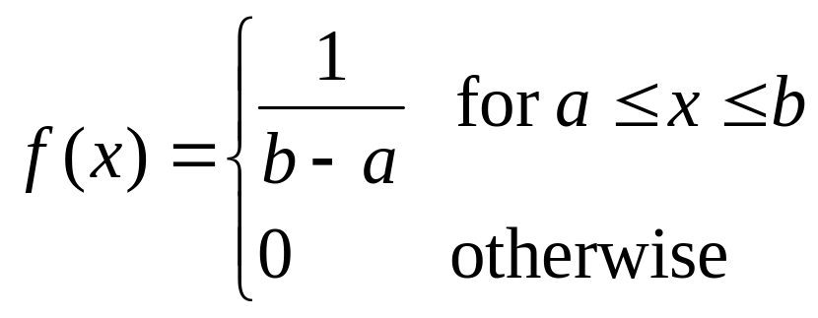
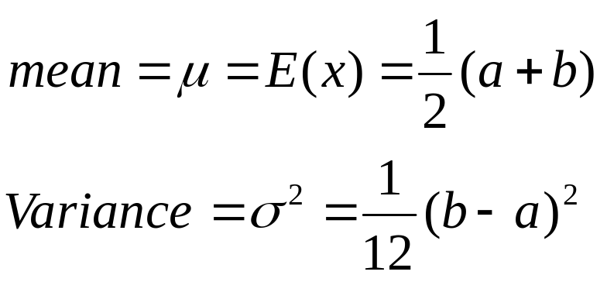
Uniform Probability Distribution
A uniform density function f is a density function that is constant

Slide 14
Uniform Probability Distribution
Example:
Assume that the weight of eggs are uniformly
distributed between 38g and 42g .
Determine the probability density function
Determine the probability that an egg selected at random will weigh more than 41g
Calculate the mean and variance of the eggs

Slide 15
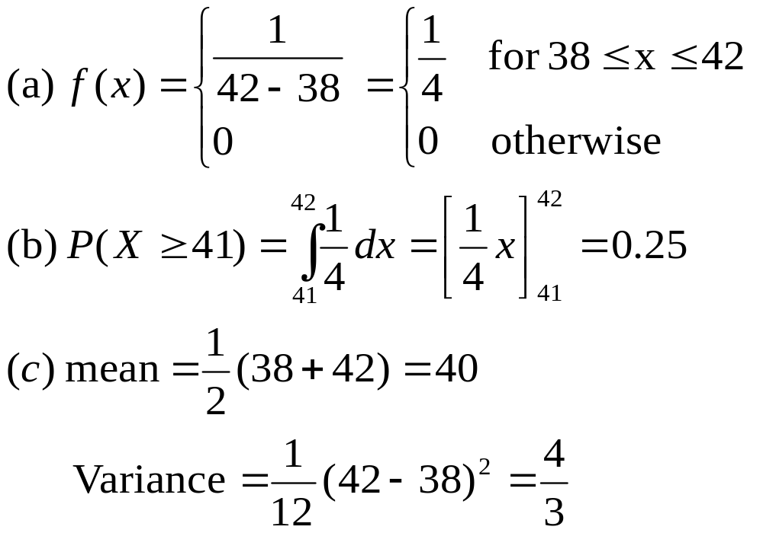
Uniform Probability Distribution
Solution

Slide 16

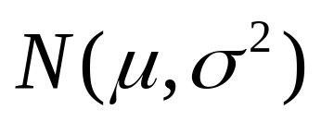
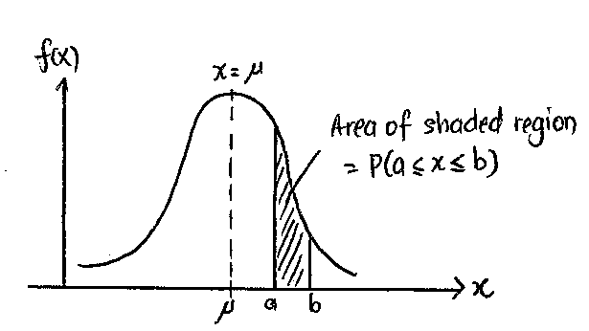
Normal Distribution
If a continuous random variable, X, is normally distributed: ~

Slide 17
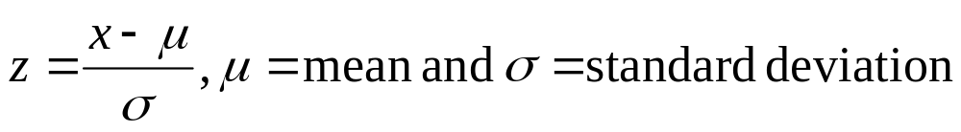
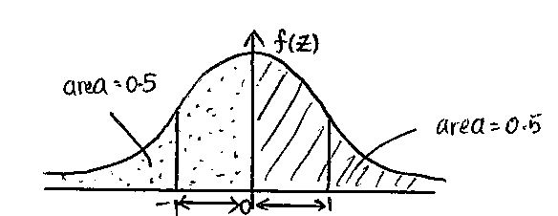
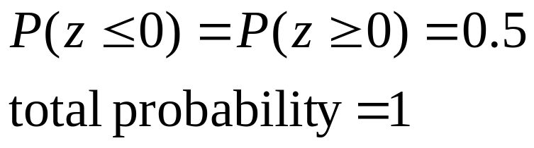
Normal Distribution
X score need to be standardized (z-score) before normally distributed:
Example…

Slide 18
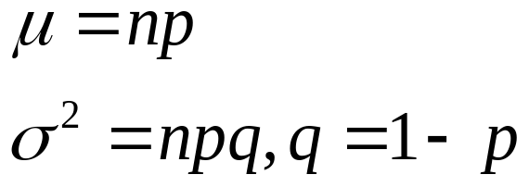
Normal Distribution
Normal approximation to Binomial distribution:
when n is large (n > 25) and p close to 0.5 → np > 5
hence,

Slide 19
Normal Distribution
For both normal approximation to Binomial we must applied CONTINUITY CORRECTION
  P(X ≤ k) ≈ P(X < k + 0.5)
  P(X < k) ≈ P(X < k - 0.5)
  P(X ≥ k) ≈ P(X ≥ k - 0.5)
  P(X > k) ≈ P(X > k + 0.5)
  P(X = k) ≈ P(k – 0.5 ≤ X < k + 0.5)
  P(a ≤ X ≤ b) ≈ P(a – 0.5 < X < b +0.5)
  P(a < X ≤ b) ≈ P(a + 0.5 < X < b +0.5)

